Slide 1
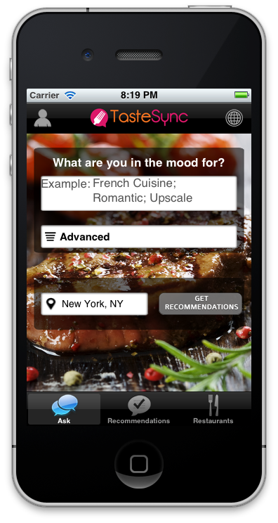
Screen 1 Ask-for-Recommendation Search

Slide 2
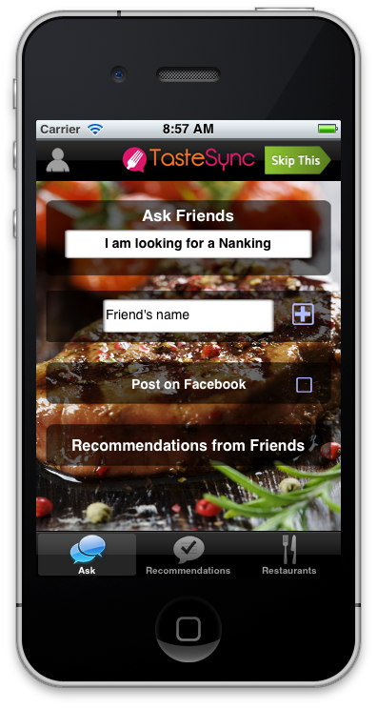
Screen 2 Ask-for-Recommendation Friends

Slide 3
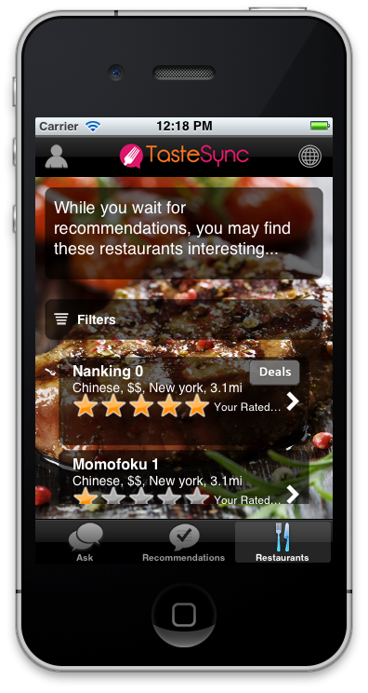
Screen 3 Restaurants While-You-Wait

Slide 4
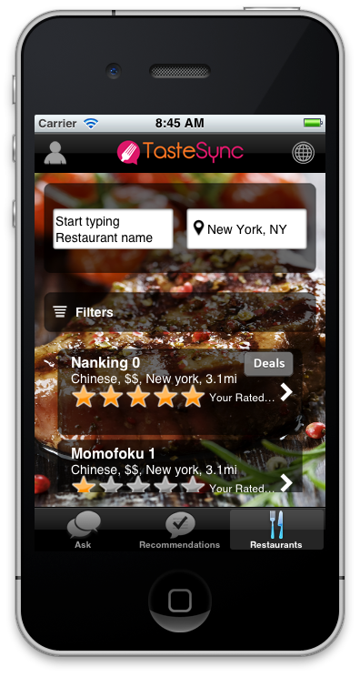
Screen 4 Restaurants Search

Slide 5
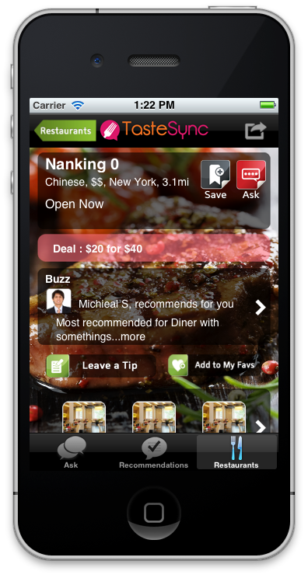
Screen 5 Restaurant Detail

Slide 6
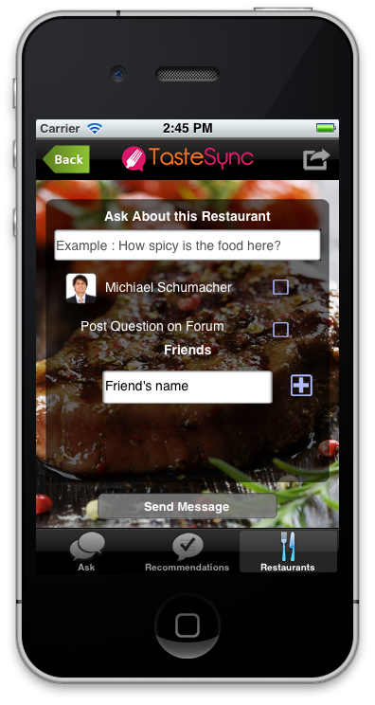
Screen 6 Restaurant Detail Ask

Slide 7
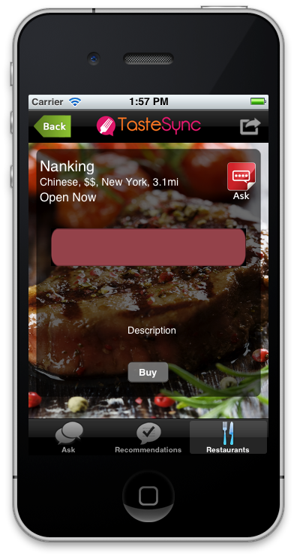
Screen 7 Restaurant Detail Deal

Slide 8
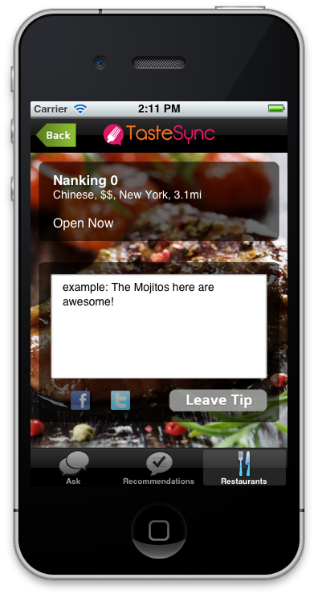
Screen 8 Restaurant Detail Tip

Slide 9
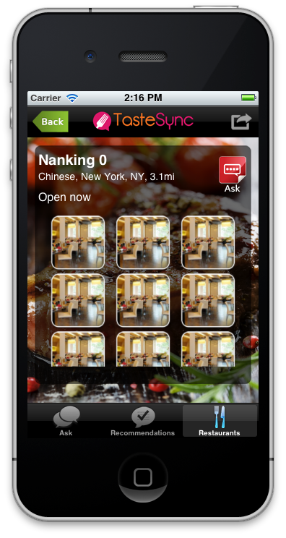
Screen 9 Restaurant Detail Photos

Slide 10
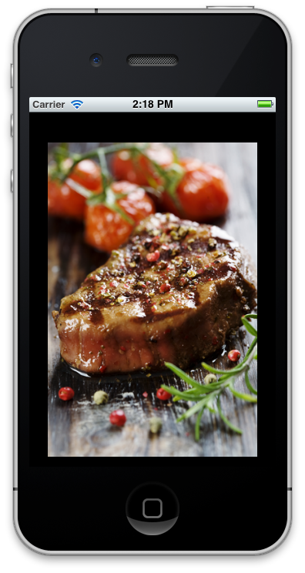
Screen 10 Restaurant Detail Photos Fullscreen

Slide 11
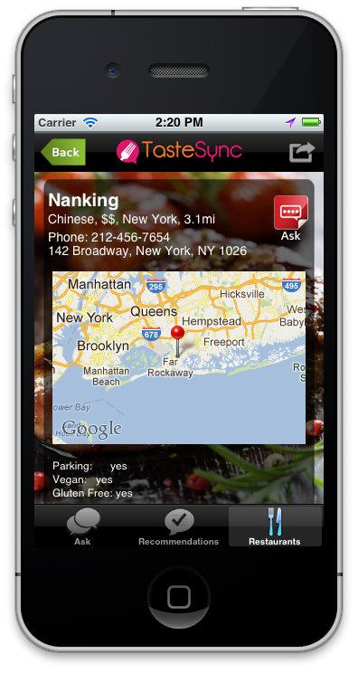
Screen 11 Restaurant Detail MoreInfo

Slide 12
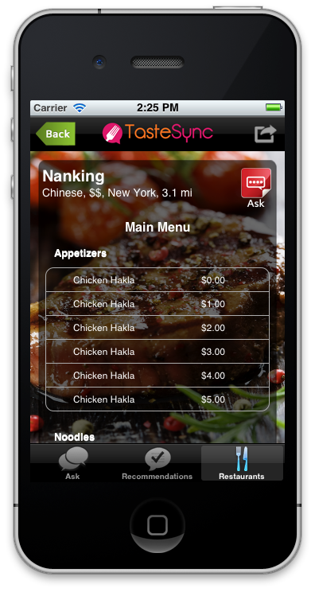
Screen 12 Restaurant Detail Menu

Slide 13
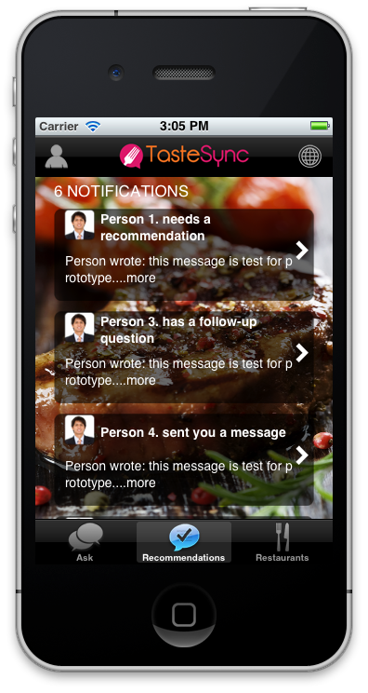
Screen 13 Recommendations List

Slide 14
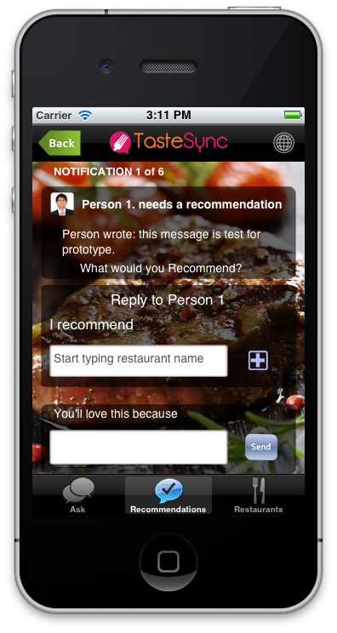
Screen 14 Recommendations Request

Slide 15
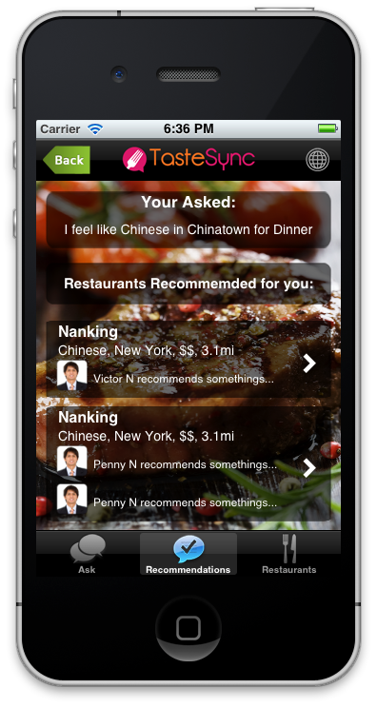
Screen 14A Recommendations ForYou

Slide 16
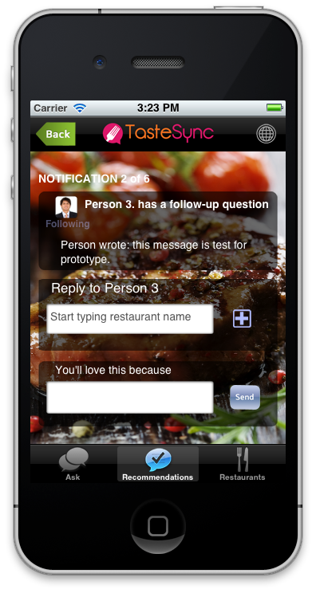
Screen 15 Recommendations Followup

Slide 17

Screen 16 Recommendations Message

Slide 18
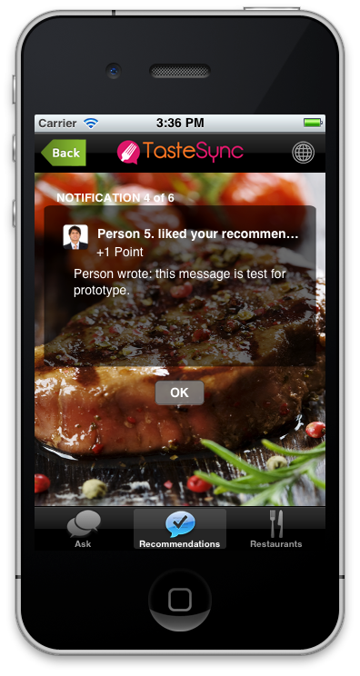
Screen 17 Recommendations ShowLike

Slide 19
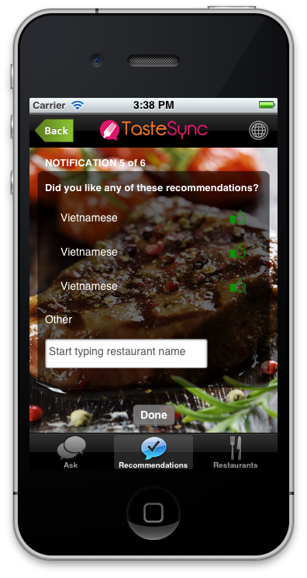
Screen 18 Recommendations DidYouLike

Slide 20
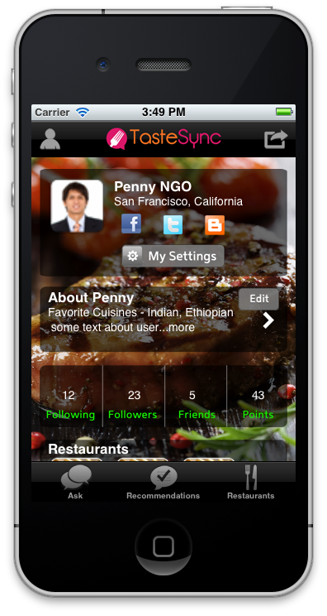
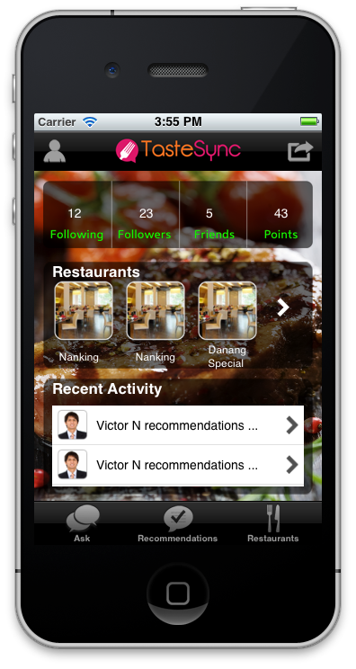
Screen 19 MyProfile Home

Slide 21
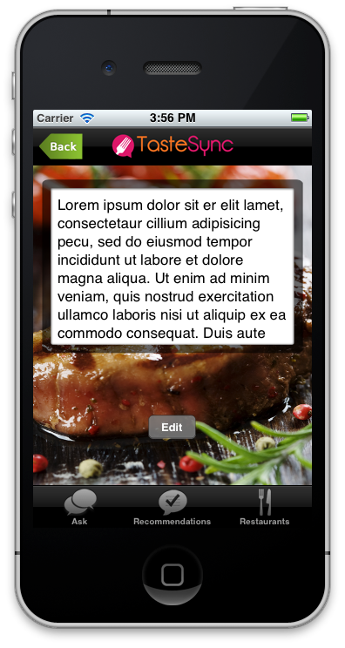
Screen 20 MyProfile AboutMe

Slide 22
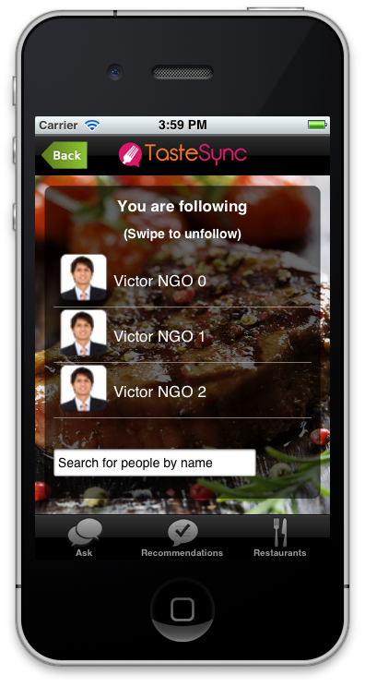
Screen 21 MyProfile Following

Slide 23
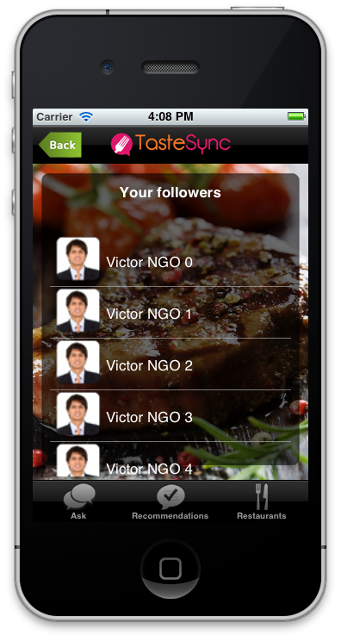
Screen 22 MyProfile Followers

Slide 24
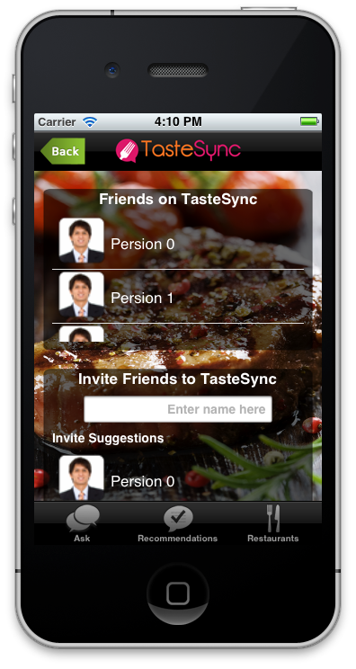
Screen 23 MyProfile Friends

Slide 25
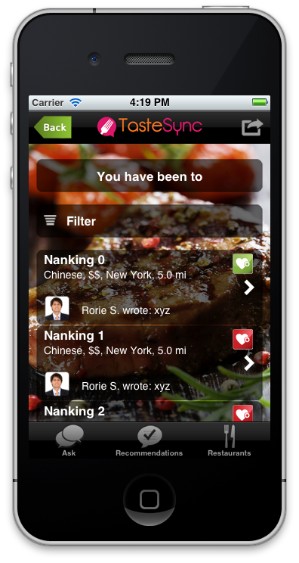
Screen 24 MyProfile Restaurants

Slide 26
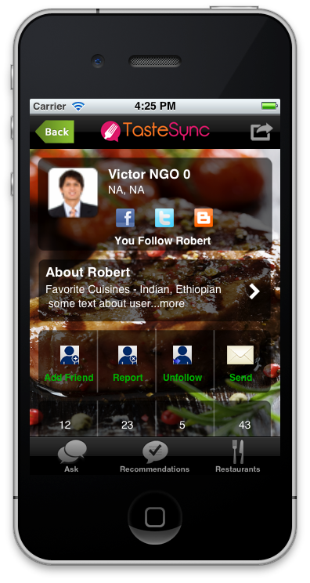
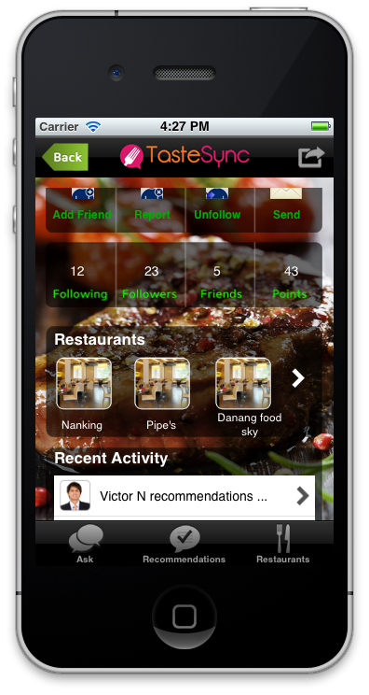
Screen 25 UserProfile Home

Slide 27

Screen 26 UserProfile AboutMe

Slide 28
Screen 27 UserProfile Following

Slide 29
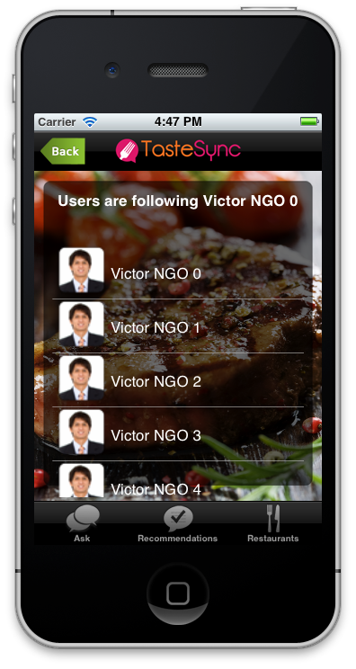
Screen 28 UserProfile Followers

Slide 30
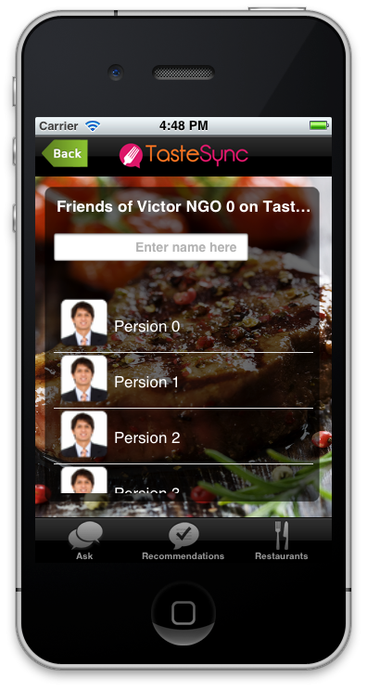
Screen 29 UserProfile Friends

Slide 31
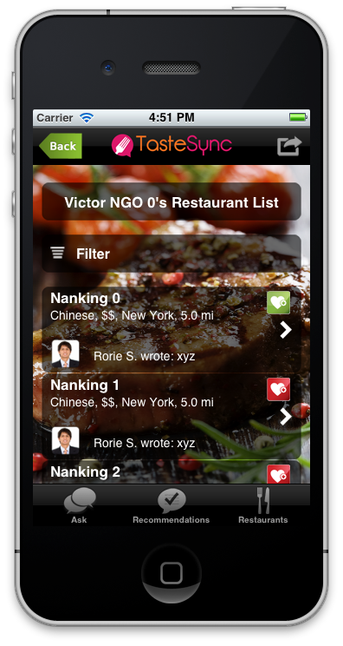
Screen 30 UserProfile Restaurants

Slide 32
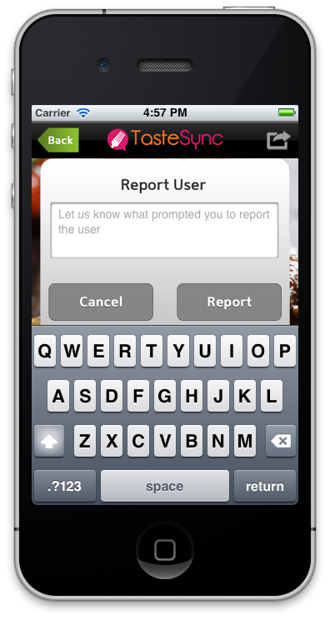
Screen 31 UserProfile Report

Slide 33
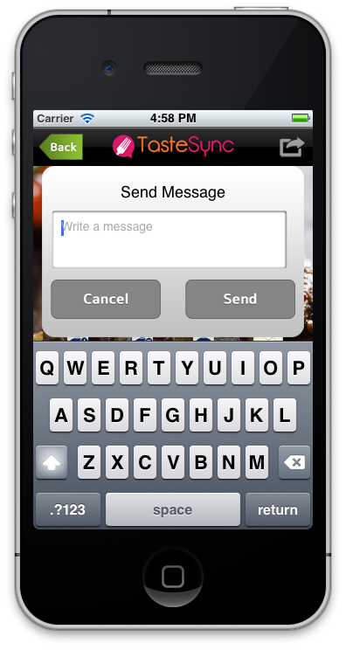
Screen 32 UserProfile SendMessage

Slide 34
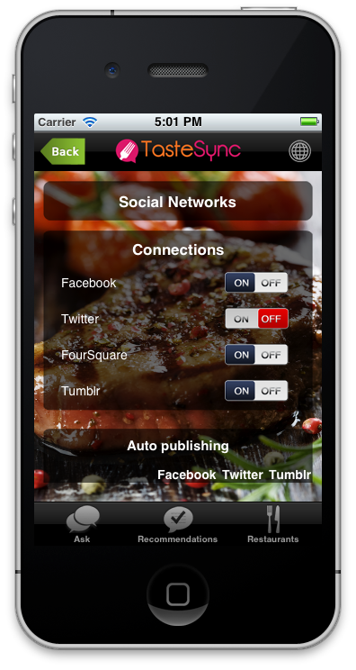
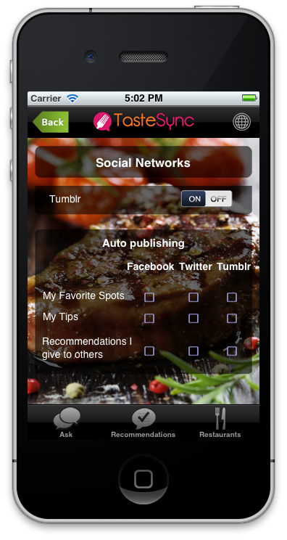
Screen 33 Settings Social

Slide 35
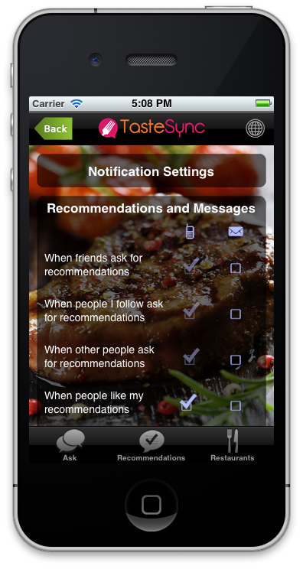
Screen 34 Settings Notification

Slide 36
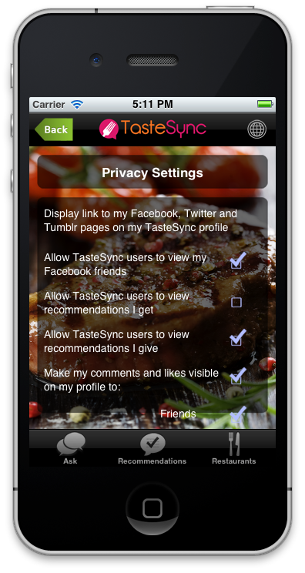
Screen 35 Settings Privacy

Slide 37
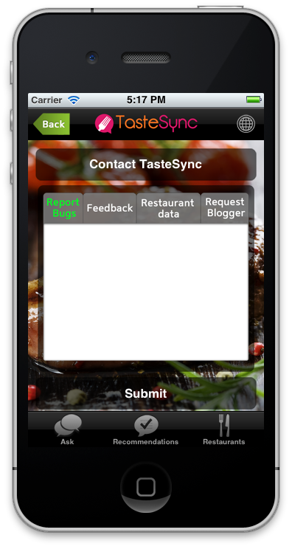
Screen 36 Settings ContactUs

Slide 38
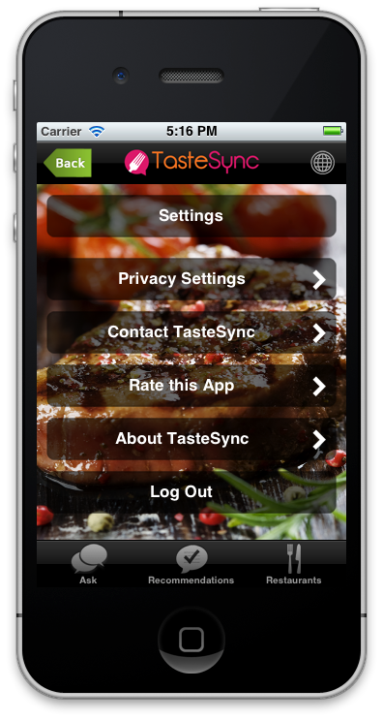
Screen 37 Settings Logout

Slide 39
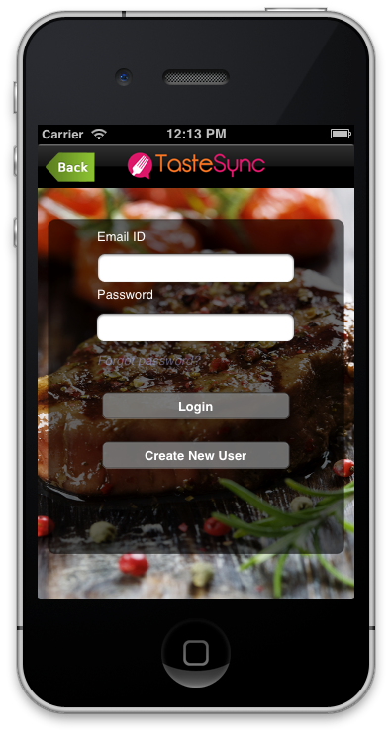
Screen 38 Login TS

Slide 40
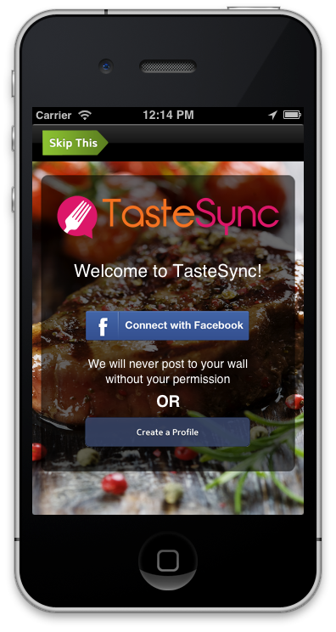
Screen 39 Login FB

